Slide 1
Module 1: Introduction to Azure Databricks
Notes:
Azure Databricks includes a considerable amount of built-in functionality around training and evaluating machine learning models.

Slide 2


Getting Started with Azure Databricks
Notes:
Let’s start with a discussion of data preparation. Data preparation is a critical job for data engineers and data scientists alike, and Azure Databricks has built-in functionality to simplify this job.

Slide 3






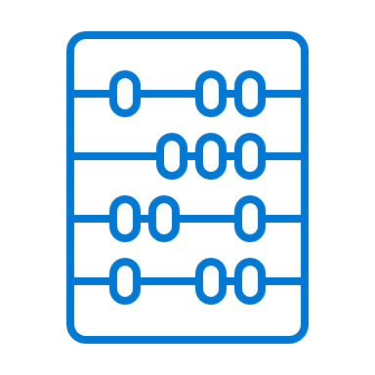



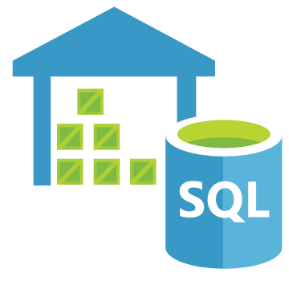
What is Azure Databricks ?
Apps
People
Azure Databricks
Analytics Platform
Deep Learning
ML
Data Science
Databricks Runtime
Streaming
Data Engineer
Power BI
Apache Spark
Business Analyst
Data Warehousing
Azure Blob
Storage
Azure Data
Lake Store
Azure SQL Data
Warehouse
Apache
Kafka
Hadoop
Storage
Notes:
Analytics platform based on Apache Spark, integrated with Azure.
Enables collaboration between data engineers, data scientists, and machine learning engineers.
Best of Databricks
* Designed in collaboration with the founders of Apache Spark * Optimized Databricks runtime engine
Best of Microsoft
* Native integration with Azure services
* Power BI, SQL DW, Cosmos DB, Blob Storage, Active Directory
So:
collaborative workspace: data engineer / data scientist / business analyst
used for: machine learning, big data analytics, datalakes, ETL, SQL queries
Integrated with Azure and external services

Slide 4
Workspaces and Clusters
Workspaces
Like folders, provide a way to organize a user’s code/notebooks, libraries, data
Each user has a separate directory
Hierarchical, allow subfolders
Allow collaboration with colleagues and access control
Clusters
Groups of nodes/machines where workloads are executed
All purpose or job-oriented
Multiple runtimes available
Allow provisioning via libraries
Multiple hardware configurations
Autoscaling, auto-termination

Slide 5

Working with notebooks
Cell types:
Runnable code
Descriptive text
Visualizations
Python
Scala
R
SQL
Markdown
DBFS utilities
Shell commands
Using cells:
Add or remove cells
Import or export cells
Run all cells, run one cell, run range of cells
View and/or clear results

Slide 6

Working with data in Azure Databricks
Notes:
Training a Machine Learning model with Azure Databricks and Spark ML is straightforward. Let’s take a look at

Slide 7


Introduction to DataFrames
Trip Distance | Total Amount
1.3 | 3
5.2 | 44
3.7 | 35
9.73 | 636
Trip Distance | Total Amount
1.3 | 9
5.2 | 41
3.7 | 31
9.73 | 65
Tabular data
Distributed
SQL API
Optimized
In-memory
Column metadata | 1 | 2
name | Trip Distance | Total Amount
type | double | double
nullable | no | no
Trip Distance | Total Amount
1.3 | 7
5.2 | 42
3.7 | 31
9.73 | 63
1, “one”, false
Spark – distributed query engine
for structured data, various formats
Structured data files
External databases
Hive tables
2, “two”, true
3, “three”, false

Slide 8
Querying DataFrames
from pyspark.sql.functions import isnan, when, count, col
from pyspark.sql.types import *
dfTrips = spark.read.csv('dbfs:/FileStore/tables/nyc_taxi.csv', header=True, inferSchema=True)
dfCompanies = spark.read.csv('wasb://spark@account.blob.core.windows.net/data/taxi_companies.csv’)
dfTripsByCompany = dfTrips.join(dfCompanies, dfTrips.companyId == dfCompanies.id).groupBy(“branch").count()
udfConvert = udf(lambda z: c_to_f(z), DoubleType())
df.filter(col('temperature').isNotNull()) \
.withColumn("tempC", col("temperature")) \
.select(col("tempC"), c_to_f(col("tempC")).alias("tempF"))
df.count() - df.dropDuplicates().count()
df.select([count(when(col(c).isNull(), c)).alias(c) for c in df.columns])
df = df.fillna({'passengerCount':'1'}).dropna()
display(df.describe())
Read/write data from multiple data sources, in multiple formats
Aggregate, join, group, union data using DataFrames
Clean data,
explore and determine statistics
Notes:
spark dataframes, tabular data structures, similar to rdbms, excel or pandas
Spark SQL and DataFrames: Spark SQL is the Spark module for working with structured data. A DataFrame is a distributed collection of data organized into named columns. It is conceptually equivalent to a table in a relational database or a data frame in R/Python.
Streaming: Real-time data processing and analysis for analytical and interactive applications. Integrates with HDFS, Flume, and Kafka.
MLlib: Machine Learning library consisting of common learning algorithms and utilities, including classification, regression, clustering, collaborative filtering, dimensionality reduction, as well as underlying optimization primitives.
GraphX: Graphs and graph computation for a broad scope of use cases from cognitive analytics to data exploration.
Spark Core API: Includes support for R, SQL, Python, Scala, and Java.

Slide 9



Visualizing Data
Use display and displayHTML functions
Multiple datatypes are supported
Dataframes
Images
Structured streaming dataframes
Multiple plot types
Bar chart, line, pie, map, area, pivot, histogram
Plot options
Choose axes (keys, values)
Grouping
Aggregations (sum, avg, min, max, count)

Slide 10
References
Microsoft Learn: Describe Azure Databricks
https://docs.microsoft.com/learn/modules/describe-azure-databricks/
Microsoft Learn: Read and write data in Azure Databricks
https://docs.microsoft.com/learn/modules/read-write-data-azure-databricks/
Microsoft Learn: Work with DataFrames in Azure Databricks
https://docs.microsoft.com/learn/modules/work-dataframes-azure-databricks/
Microsoft Azure Databricks: Documentation
https://docs.microsoft.com/azure/databricks/
Notes:
Use the references on the slide to learn more. In particular, note the online learning modules on Microsoft Learn that are related to the material covered in this module.

Slide 11
Module 2: Training and Evaluating Machine Learning Models
Notes:
Azure Databricks includes a considerable amount of built-in functionality around training and evaluating machine learning models.

Slide 12
Preparing Data for Machine Learning
Notes:
Let’s start with a discussion of data preparation. Data preparation is a critical job for data engineers and data scientists alike, and Azure Databricks has built-in functionality to simplify this job.

Slide 13
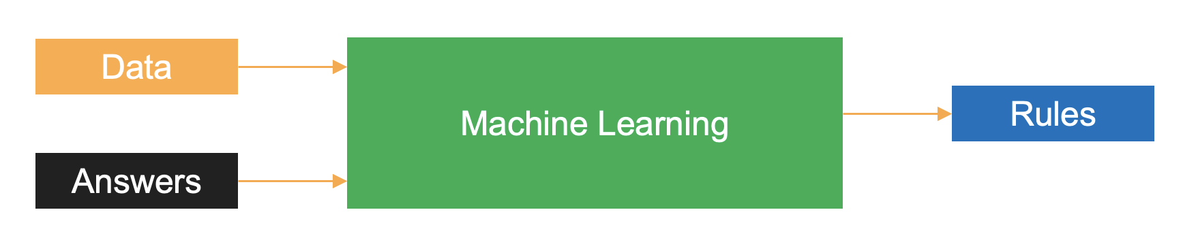
What is Machine Learning?
Take data and answers (labels)
Generate rules to map new data to labels
Notes:
In traditional programming, the inputs of hard coded rules and data are used to arrive at the output of answers. By contrast, in machine learning, you train the algorithm with data and answers, also known as labels, and the algorithm learns the rules to map the data to their respective labels.

Slide 14
Data Cleaning
Impute NULL Values
Drop records
Impute “best guess” values
Handle Duplicated Records
Drop duplicate records
Convert Data Types
Convert strings to other data types
Translate integer to float values
Handle Outliers
Outlier: an observation significantly different from other observations
Might drop extreme values
Notes:
Data scientists spend a lot of time cleaning data. This includes everything from handling missing and duplicate data to converting data between different types, handling outliers, and more. Data rarely comes in perfectly and data scientists will perform a considerable amount of work in making it acceptable.
One common issue is figuring out how to handle missing data. This includes data which might be stored with NULL in the database or an empty string or 0 value in a data set. For critical missing data, it may make sense to drop records, although there is a risk of losing important information if you drop too many rows.
Duplicated rows are typically not a problem for data science projects, but if you do have a large number of duplicates, it is easy to drop them without much consequence.
Data type conversion is usually important when transferring data between source systems.
Finally, outliers are a special topic for data cleaning. An outlier is an observation which is significantly different from other observations. You can measure and potentially drop outliers, as they may represent bad data. But if the outliers are real data, it is important to retain them, as they represent valid information your model should handle.

Slide 15
Feature Engineering
Feature Engineering
Aggregation (count, sum, etc.)
Binning (group into bins and aggregate)
Flagging (creating Boolean flags)
Embedding (transforming categorical or text features into new features)
Feature Selection
Remove features from a dataset
Why?
Remove highly correlated features
Simplify model explanation
Prevent a model from using inappropriate features
Notes:
After cleaning data, the next major task is featurizing—that is, shaping inputs in a way which makes sense for a machine learning algorithm. Two common practices here are feature engineering and feature selection.
Feature engineering is the process of taking input data and changing it in some way to generate new features. One example of this is aggregating individual events to get the count of events by day.
Feature selection is the process of removing features from a dataset. If features are highly correlated with one another or provide very little benefit to the training process, it can make sense to remove them altogether. Another reason to perform feature selection is to prevent a model from using inappropriate features. For example, suppose your dataset includes a feature which you are legally not allowed to use. Feature selection makes a lot of sense here to prevent a model from even knowing about the feature.

Slide 16
Data Scaling
Data normalization
Rescale the data into the range [0, 1]
Many algorithms have trouble with widely disparate feature ranges
Data standardization
Rescale to have mean = 0 and standard deviation = 1
Weeks at Current Job (Original) | Weeks at Current Job (Norm’d)
0 | 0.0000
30 | 0.0300
42 | 0.0420
399 | 0.3990
399.1 | 0.3991
1000 | 1.0000
Salary in USD (Original) | Salary in USD (Norm’d)
$10,000 | 0.0043
$50,000 | 0.0217
$100,000 | 0.0435
$250,000 | 0.1087
$500,000 | 0.2174
$2,300,000 | 1.0000
Notes:
The next task to cover is data scaling. There are two tasks in data scaling that are important: normalization and standardization. The goal of both tasks is to shape the distribution of the data in a more standard fashion. Normalization rescales data into the range from 0 to 1. The benefit here is that all features will fit along the same range while each feature retains the same distribution. This can be helpful because many algorithms have trouble with features which vary considerably in scale—for example, if you include the number of weeks a person has worked at a job and their salary in US dollars, we have several orders of magnitude difference, and this might make a minor change in salary have much more impact than a minor change in age. Moving everything to a range from 0 to 1 evens out the consideration of each variable by the algorithm.
Data standardization shifts distributions to have a mean of 0 and a standard deviation of 1.

Slide 17
Data Encoding
Input Data
Item | Color | Price | In Stock
Shirt | Red | 19.95 | True
Shirt | Blue | 19.95 | False
Shirt | Black | 21.95 | True
Jeans | Blue | 49.99 | True
Jeans | Black | 49.99 | True
Coat | Black | 149.99 | True
Coat | Brown | 144.99 | True
One-Hot Encoded Data
Item_Shirt | Item_Jeans | Item_Coat | Color_Red | Color_Blue | Color_Black | Color_Brown | Price | In Stock
1 | 0 | 0 | 1 | 0 | 0 | 0 | 19.95 | 1
1 | 0 | 0 | 0 | 1 | 0 | 0 | 19.95 | 0
1 | 0 | 0 | 0 | 0 | 1 | 0 | 21.95 | 1
0 | 1 | 0 | 0 | 1 | 0 | 0 | 49.99 | 1
0 | 1 | 0 | 0 | 0 | 1 | 0 | 49.99 | 1
0 | 0 | 1 | 0 | 0 | 1 | 0 | 149.99 | 1
0 | 0 | 1 | 0 | 0 | 0 | 1 | 144.99 | 1
Notes:
Data encoding is the process of translating categorical data into come which machine learning algorithms can understand. One-hot encoding is a popular technique for doing this. The idea is to take a categorical feature, such as Item or Color in the table above, and create one new feature for every distinct category for the existing feature. For Item, that means creating three new features: one for shirt, one for jeans, and one for coat. For color, we create four new features. Then, we populate each of the new features with 1 or 0, depending on whether the value of the old feature matched the description of the new feature. If the Item value was Shirt, then the value for Item_Shirt will be 1; otherwise, it will be 0. We repeat that for each new feature. Finally, we remove the original Item and Color features, leaving their encoded values.
Boolean columns like In Stock are a special case, where there are only two valid values for the category. In this case, we can still perform One-Hot Encoding and retain the new feature where In Stock is True. That way, if a machine learning algorithm does not understand Boolean True and False, it can at least understand the numeric 1 and 0. This also applies to any other category with just two values, such as if you were comparing Product A to Product B.

Slide 18
Training a Machine Learning Model
Notes:
Training a Machine Learning model with Azure Databricks and Spark ML is straightforward. Let’s take a look at

Slide 19



Introduction to Spark ML
Two approaches, one library:
MLLib
Legacy approach
Designed to use Resilient Distributed Datasets
In maintenance mode
Spark ML
Current approach
Designed to use DataFrames
In active development
Notes:
There is one library in Spark which supports machine learning. The confusing thing about this is that there are two separate approaches within the same library: MLLib and Spark ML.
MLLib is the legacy approach to machine learning in Apache Spark. It was built off of the Resilient Distributed Datasets data structure and is currently in maintenance mode. The recommendation is not to develop any new code off of MLLib.
Instead, write code off of Spark ML. This is in active development and is built off of the newer and easier-to-work-with DataFrames approach.

Slide 20


A Typical Training and Validation Process
Three key steps:
Splitting data: use the randomSplit() method
Training a model: use the fit() method
Validating a model
Review built-in summary statistics for training quality
Call fit() with new data for validation
Helps detect overfitting
Three key abstractions
Transformers: perform feature engineering and feature selection
Estimators: fit models
Pipelines: link together transformers and estimators
Transformers take DataFrames and output DataFrames
Estimators take DataFrames and return Models
Pipelines combine transformers and estimators
Notes:
There are three steps which make up the training and validation process when using Spark ML. The first step is to split data using the randomSplit() method. This method takes a DataFrame and a pair of percentages, which determine what percentage of rows show up in the first returned DataSet and what percentage of rows show up in the second. Records are also shuffled as part of this process.
The second step involves training a model. Spark ML offers a fit() method which is used for model training. This method takes a DataFrame and returns a generated model.
Once you have a trained model, there are two parts to validation. The first part involves reviewing built-in summary statistics for training quality. This gives you an idea of how well the model performed during training. Then, if you call fit() against data the model has not yet seen, you can review the same summary statistics for this new dataset. These values will typically be somewhat lower than the training data, but if there is a major difference, that is a sign of overfitting, where the training process has latched onto peculiarities in the dataset which do not exist outside of that training data.
There are three key abstractions when working with Spark ML: transformers, estimators, and pipelines.
Transformers accept DataFrames and return DataFrames. This is useful for performing activities such as feature engineering and feature selection. This approach also allows individual transformations to be fairly simple—instead of a complex process which modifies many things at once, you can perform small transformations in each step and get to the same end result.
The second abstraction is the estimator. Estimators take DataFrames and return trained models. Two examples of estimators include the LinearRegression and LogisticRegression estimators.
The third abstraction is the pipeline. Pipelines are how we combine together the individual transformer and estimators, using them as processing steps.

Slide 21
Other Frameworks
Support for a variety of third party libraries. Examples:
Keras
PyTorch
TensorFlow
XGBoost
Use the Databricks Runtime for Machine Learning
Comes with a variety of libraries pre-installed
Notes:
Azure Databricks supports machine learning frameworks other than Spark ML / MLLib. For example, Azure Databricks offers support for popular libraries like TensorFlow and PyTorch.
It is possible to install these libraries directly, but the best recommendation is to use the Databricks Runtime for Machine Learning. This comes with a variety of machine learning libraries pre-installed, including TensorFlow, PyTorch, Keras, and XGBoost. It also includes libraries essential for distributed training, allowing data scientists to take advantage of the distributed nature of Apache Spark.

Slide 22
References
Microsoft Learn: Perform machine learning with Azure Databricks
https://docs.microsoft.com/learn/modules/perform-machine-learning-with-azure-databricks/
Microsoft Learn: Train a machine learning model
https://docs.microsoft.com/learn/modules/train-machine-learning-model/
Machine learning tutorial
https://docs.microsoft.com/azure/databricks/getting-started/spark/machine-learning
Notes:
Use the references on the slide to learn more. In particular, note the online learning modules on Microsoft Learn that are related to the material covered in this module.

Slide 23
Module 3: Managing Experiments and Models
Notes:
Like any scientific discipline, data science involves running experiments, typically to explore data or to build and evaluate predictive models. With MLflow, Azure Databricks gains the ability to track executions of code, called runs, and generate metrics and outputs. We can use the Azure Databricks user interface or its API to investigate and work with experiments and runs.

Slide 24


Using MLflow to Track Experiments
Notes:
Let's start by exploring experiments, and how to run them using the Azure Machine Learning Python SDK.

Slide 25
What is MLflow?
MLflow Tracking allows scientists to work with experiments
MLflow Projects package up code for deployment and reproducibility
MLflow Models offer a standardized format for models
MLflow Model Registry allows data scientists to register and version models
Notes:
MLflow is an open source product designed to manage the Machine Learning development lifecycle. That is, MLflow allows data scientists to train models, register those models, deploy the models to a web server, and manage model updates. It is made up of four components.
MLflow Tracking allows data scientists to work with experiments.
MLflow Projects allow data scientists to package up their code in a manner which allows for consistent deployment and the ability to reproduce results.
MLflow Models provides a standardized format for models. This allows MLflow to work with models generated from popular libraries such as scikit-learn, TensorFlow, Keras, PyTorch, Mllib, and more.
Finally, the MLflow Model Registry allows data scientists to register and version models. Model registration makes it easy to deploy models, and model versioning makes it easy to track changes over time and test candidate models before they go out into production.

Slide 26
MLflow Terminology
Tracking
Run: execution of code for a data science task
Parameter: Model inputs, such as hyperparameters
Metric: Model evaluation measures
Artifact: Output files
Experiment: a collection of runs
Projects
Project: method of packaging data science code
Entry point: starting point of a project
Environment: specific packages (and versions) used in developing a project
Models
Flavor: descriptor of which tool or library generated a model
Signature: expected model inputs and outputs
Model Registry
Register: store details about a model
Version: a registered iteration of a model
Stage: a tag indicating the status of a version
Notes:
Each MLflow component has its own set of key terminology.
MLflow Tracking has two key concepts: runs and experiments. A run is an individual execution of code for a data science task. Each run is made up of several tracked features, including parameters, metrics, and artifacts. We can then wrap a collection of runs up as an experiment.\
For MLflow Projects, a project is simply a method of packaging data science code. Each package has an entry point, which is the starting shell or Python script. Packages also have an environment, which is the individual requirements for building a project.
MLflow Models are built around flavors, that is, the tool or library which generated the model. This allows MLflow to work with a variety of libraries, such as TensorFlow, PyTorch, or Spark ML. Each model also has a signature, which is the expected set of inputs and outputs for a model.
The Model Registry is the final component. To register a model is to store details about that model in a central repository. Each model may have multiple versions, or iterations, of the model. With multiple versions, it makes sense to tag different versions of models as things like Staging or Production, which is called staging a model version.

Slide 27
Creating and Running Experiments
Script
Optionally name an experiment
import mlflow
experiment = Experiment(name='mlflow-experiment')
mlflow.set_experiment(experiment.name)
with mlflow.start_run():
mlflow.log_param('input1', 14)
mlflow.log_param('input2', 42)
# Perform model training and evaluation
mlflow.log_metric('my_metric', 123)
mlflow.sklearn.log_model(trained_model, 'model')
mlflow.sklearn.save_model(trained_model, model_path)
mlflow.log_artifact(image_location)
Create and start an MLflow run
Parameters are inputs used for model training
Metrics are outputs used for model evaluation
Write and save the model in a known directory
Optionally write out additional artifacts
Notes:
In MLflow, experiments are named executable processes (usually based on scripts) that can be run one or more times. Each experiment run will track the parameters used to perform machine learning model training, as well as outputs generated by the training process. These are recorded for future review. Additionally, metadata for the experiment run and events that occur during the run are logged. This may also include artifacts such as the model itself, images created during modeling, or log files created as part of the experiment.
MLflow Tracking uses experiments and runs as its key objects. Creating an experiment is optional inside a notebook; if you do not explicitly create an experiment, your experiment’s name will be the same as the notebook’s.
The start_run() function provides a scope for the context of the run. Use the with mlflow.start_run() syntax so that you do not need to call a function to stop the run.
Inside a run, there are separate methods to log parameters, metrics, and artifacts. In addition, there is a method to save the model. This method to save the model will depend on the flavor--that is, the library used for training. In this case, we used scikit-learn to perform model training.

Slide 28
Managing Models
Notes:
Training a great model is a start to a data science project, but having a trained model that existed in a notebook on a cluster at one point in time will not be enough. This is where model management comes into play.

Slide 29
Model Management Overview
Model Registration
Store details of a model in the MLflow Model Registry
Users retrieve the model from the registry for use
Can serve models on Azure Databricks or in Azure Machine Learning
Model Versioning
Try out new candidate models
Retain information on prior versions of models—compare old versus new
Notes:
The two key steps for model management in MLflow are registration and versioning of models. With registration, a data scientist stores the details of a model in the MLflow Model Registry, along with a name for ease of access. Users can retrieve the model from the registry and use that model to perform inference on new data sets. Further, it is possible to serve models on Azure Databricks or in Azure Machine Learning, automatically generating a REST API to interact with the model.
Once a model is out in production, there is still more work to do. As models change over time, model management becomes a process of training new candidate models, comparing to the current version and prior candidate models, and determining whether a candidate is worthy of becoming the next production model. MLflow's versioning system makes this easy by labeling new versions of models and retaining information on prior model versions automatically. This allows a data scientist to perform testing on a variety of model versions and ensure that new models are performing better than older models.

Slide 30
Registering a Model
Register from an experiment:
Register during a run:
Retrieve registered models
model_details = mlflow.register_model(model_uri=model_uri, name=model_name)
Model saved in run outputs
with mlflow.start_run() as run:
mlflow.log_params("param1", 123)
mlflow.sklearn.log_model(
sk_model=model,
artifact_path="model",
registered_model_name="sklearn Trained Model")
Local model generated during a run
Models are automatically versioned based on name
model = mlflow.sklearn.load_model(
model_uri=f"models:/{model_name}/{model_version}")
Notes:
Model registration enables you to track multiple versions of a model, and retrieve models for inferencing (predicting label values from new data). When you register a model, you can specify a name, description, tags, and other useful metadata.
After running a training experiment, you can use the reference to mlflow’s register_model method to register a model that was saved in at a specified URI.
Alternatively, you can call the log_model method for a particular flavor of model and use the registered_model_name parameter to create a new model or version an existing model.
Registering a model with the same name as an existing model automatically creates a new version of the model, starting with 1 and increasing in units of 1.

Slide 31
Model Versioning
Transition a model version to a new stage:
Retrieve a model at a particular stage:
client.transition_model_version_stage(
name=model_details.name,
version=model_details.version,
stage=‘Staging’,
)
Use this method to transition to Production, Archived, or custom states
import mlflow.pyfunc
model_uri = "models:/{model_name}/{model_stage}".format(model_name=model_name, model_stage=model_stage)
model = mlflow.pyfunc.load_model(model_uri)
Load the latest version of a model in a particular stage.
Notes:
Use the transition_model_version_stage method to move a model version from one stage to another. It’s easy to think of these stages as steps in a workflow. By default, MLflow has four stages: None, which is the default stage; Staging; Production; and Archived, where a model version is no longer intended to serve.
To retrieve a model at a particular stage, use the load_model method and pass in the model name and the model stage. This makes it easy for an application to get the current production version of a model without needing to keep track of model version numbers. In the event that there are multiple model versions marked in a given stage, this method returns the version with the highest version number—that is, the latest registered version within a given stage.

Slide 32
References
Microsoft Learn: Work with MLflow in Azure Databricks
https://docs.microsoft.com/learn/modules/work-with-mlflow-azure-databricks/
MLflow guide for Azure Databricks
https://docs.microsoft.com/azure/databricks/applications/mlflow/
Notes:
Use the references on the slide to learn more. In particular, note the online learning modules on Microsoft Learn that are related to the material covered in this module.

Slide 33
Module 4: Integrating Azure Databricks and Azure Machine Learning
Notes:
In this module, we'll explore how to integrate Azure Databricks and Azure Machine Learning.

Slide 34
Tracking Experiments with Azure Machine Learning
Notes:
Azure Machine Learning is a platform for operating machine learning workloads in the cloud. In this section we will look at how to run and track Azure Machine Learning experiments running on Azure Databricks compute cluster.

Slide 35
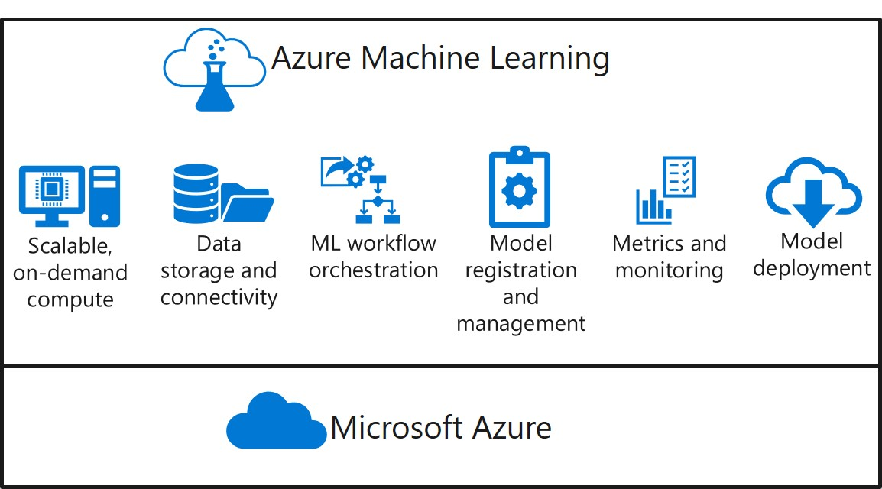
What is Azure Machine Learning?
Azure Machine Learning is a platform for operating machine learning workloads in the cloud.
Notes:
Azure Machine Learning is a platform for operating machine learning workloads in the cloud.
Built on the Microsoft Azure cloud platform, Azure Machine Learning enables you to manage:
- Scalable on-demand compute for machine learning workloads.
- Data storage and connectivity to ingest data from a wide range sources.
- Machine learning workflow orchestration to automate model training, deployment, and management processes.
- Model registration and management, so you can track multiple versions of models and the data on which they were trained.
- Metrics and monitoring for training experiments, datasets, and published services.
- Model deployment for real-time and batch inferencing.

Slide 36
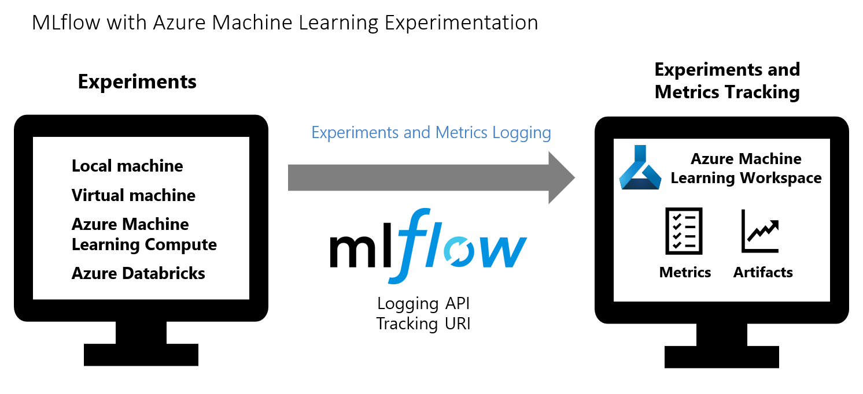
Running Azure Machine Learning Experiments on Databricks Compute
Use MLflow Tracking to track an experiment's run metrics and store model artifacts in Azure Machine Learning workspace
Notes:
MLflow is an open-source library for managing the life cycle of your machine learning experiments.
MLFlow Tracking is a component of MLflow that logs and tracks your training run metrics and model artifacts, no matter your experiment's environment.
A recommended approach for running Azure Machine Learning Experiments on Azure Databricks cluster is use MLflow Tracking and connect Azure Machine Learning as the backend for MLflow experiments.
Thus, using MLflow integration with Azure Machine Learning, you can run experiments in Azure Databricks compute and leverage Azure Machine Learning workspace capabilities of centralized, secure, and scalable solution to store model training metrics and artifacts.

Slide 37
Logging Azure Machine Learning experiment metrics with ML Flow
Configure MLflow tracking to use AML
Configure and run a MLflow experiment
Log your model metrics and artifacts via MLflow tracking APIs
with mlflow.start_run() as run:
…
…
mlflow.log_metric('rmse', rmse)
…
…
mlflow.log_artifact("./outputs/results.png")
Notes:
First, you configure MLflow tracking to use AML as its backend for MLflow experiments
Next, you configure and start a MLflow experiment
In you MLflow experiment, once you train and evaluate your model, you can use the MLflow logging API, mlflow.log_metric(), to start logging your model metrics as shown
You can also log model artifacts, such as evaluation graphs, log files or directory contents, using the mlflow.log_artifact() API
Since Azure Machine Learning is setup as the backend for MLflow experiments, you can review all the training metrics and artifacts in a corresponding Azure ML Workspace experiment run
You'll see an example of logging metrics with MLflow to an Azure ML experiment run in the lab at the end of this lesson.

Slide 38
Running Azure Machine Learning Pipeline on Databricks Compute
Attach Azure Databricks Compute to Azure Machine Learning workspace
Define DatabricksStep in a Pipeline
Submit the Pipeline
databricksStep = DatabricksStep(name = "process_data",
spark_version = "7.3.x-scala2.12",
node_type = "Standard_DS3_v2",
num_workers = 1,
python_script_name = script_name,
pypi_libraries = [PyPiLibrary(package = 'scikit-learn'),
PyPiLibrary(package = 'azureml-sdk')],
compute_target = databricks_compute
)
Notes:
Azure Machine Learning support a specialized pipeline step called DatabricksStep that setup to run a notebook, script, or compiled JAR on a databricks cluster. In order to run a pipeline step on databricks cluster, you need the following:
Attach Azure Databricks Compute to Azure Machine Learning workspace
Define DatabricksStep in a Pipeline
Submit the Pipeline
The shown step in the slide, defines the configuration to create a new Databricks job cluster to run the python script. The cluster is created on the fly to run the script and the cluster is subsequently deleted after the step execution is completed.
After defining the step, you can assign it to a pipeline, and run it as an experiment in Azure Machine Learning workspace.

Slide 39

Deploying Models
Notes:
In machine learning, Model Deployment can be considered as a process by which you integrate your trained machine learning models into production environment such that your business or end user applications can use the model predictions to make decisions or gain insights into your data.

Slide 40


What is Real-Time Inferencing?
Model Deployment Overview
In machine learning, Model Deployment can be considered as a process by which you integrate your trained machine learning models into production environment such that your business or end user applications can use the model predictions to make decisions or gain insights into your data.
Immediate prediction from new data
Usually deployed as a web service endpoint
y=1
Notes:
In machine learning, Model Deployment can be considered as a process by which you integrate your trained machine learning models into production environment such that your business or end user applications can use the model predictions to make decisions or gain insights into your data.
The term *inferencing* refers to the use of a trained model to predict labels for new data on which the model has not been trained. Often, the model is deployed as part of a service that enables applications to request immediate, or *real-time*, predictions for individual or small numbers of data observations.
Client applications consume the service through an endpoint, submitting new feature data and receiving an immediate response with predicted labels.
In Azure Machine learning, you can create realtime inferencing solutions by deploying a model as a realtime service, hosted in a containerized platform such as Azure Kubernetes Services (AKS).

Slide 41
Azure ML Deployment Endpoints
Compute Target | Usage | Description
Local web service | Testing/debug | Good for limited testing and troubleshooting.
Azure Kubernetes Service (AKS) | Real-time inference | Good for high-scale production deployments. Provides autoscaling, and fast response times.
Azure Container Instances (ACI) | Testing | Good for low scale, CPU-based workloads.
Azure Machine Learning Compute Clusters | Batch inference | Run batch scoring on serverless compute. Supports normal and low-priority VMs.
Azure IoT Edge | (Preview) IoT module | Deploy & serve ML models on IoT devices.
Notes:
You can deploy a model to several kinds of compute target, including local compute, an Azure Container Instance (ACI), an Azure Kubernetes Service (AKS) cluster, Azure Machine Learning Compute Clusters or an Internet of Things (IoT) module.
Note: Deployment to a local service, or an ACI is a good choice for testing and development. For production, you should deploy to a target that meets the specific performance, scalability, and security needs of your application architecture.

Slide 42
Model Deployment Process
Register a trained model
Define an Inference Configuration
Create a scoring script (implement init() and run() functions to load the model and return predictions)
Create an environment
Define a Deployment Configuration
Create a Compute Target (for example: local, Azure Container Instance, AKS cluster)
Deploy the model as a service
service = Model.deploy(ws, 'my_service', [model], inference_config, deploy_config)
Notes:
You can deploy a model as a inferencing web service to several kinds of compute targets as discussed in the previous slide. Azure Machine Learning uses containers as a deployment mechanism, packaging the model and the code to use it as an image that can be deployed to a container in your chosen compute target.
To deploy a model as a inferencing webservice, you must perform the following tasks:
Register a trained model
Define an inference Configuration that comprises of the scoring script and deployment environment
Define a deployment configuration that specifies the compute target
Finally, deploy the model as a scoring webservice passing in the registered model, inference configuration and deployment configuration
You'll see an example of model deployment in the lab at the end of this lesson.

Slide 43
Troubleshooting Deployment
Check the service state
Review service logs
Deploy to a local container
Modify entry script to debug, and then reload to test
print(service.state)
print(service.get_logs())
deployment_config = LocalWebservice.deploy_configuration(port=8890)
service = Model.deploy(ws, 'test-svc', [model], inference_config, deployment_config)
service.reload()
service.run(input_data=test_sample)
Notes:
There are a lot of elements to a real-time service deployment, including the trained model, the runtime environment configuration, the scoring script, the container image, and the container host. Troubleshooting a failed deployment, or an error when consuming a deployed service can be complex.
As an initial troubleshooting step, you can check the status of a service by examining its state.
Note: To view the state of a service, you must use the compute-specific service type (for example AksWebservice) and not a generic WebService object.
For an operational service, the state should be *Healthy*.
If a service is not healthy, or you are experiencing errors when using it, you can review its logs, which include detailed information about the provisioning of the service, and the requests it has processed; and can often provide an insight into the cause of unexpected errors.
Deployment and runtime errors can be easier to diagnose by deploying the service as a container in a local Docker instance. You can then test the locally deployed service using the SDK and troubleshoot runtime issues by making changes to the scoring file that is referenced in the inference configuration, and reloading the service without redeploying it (something you can only do with a local service).

Slide 44
References
Train and track ML models with MLflow and Azure Machine Learning documentation
https://docs.microsoft.com/azure/machine-learning/how-to-use-mlflow
MLflow Tracking API documentation
https://mlflow.org/docs/latest/quickstart.html#using-the-tracking-api
Microsoft Learn: Deploy real-time machine learning services with Azure Machine Learning
https://docs.microsoft.com/learn/modules/register-and-deploy-model-with-amls
Microsoft Learn: Deploy batch inference pipelines with Azure Machine Learning
https://docs.microsoft.com/learn/modules/deploy-batch-inference-pipelines-with-azure-machine-learning
Azure Machine Learning model deployment documentation
https://docs.microsoft.com/azure/machine-learning/how-to-deploy-and-where

Slide 45
Closing slide

